Slide 1

Design Thinking Module 001
Group number- C5
Group members:
Chandana MN - CSE060
AISHWARYA RAJESH – CSE006
PREM KUMAR S – LCSE107
RAUT ADESH DNYANDEO – AE006

Slide 2

Understand the design thinking skills

Slide 3
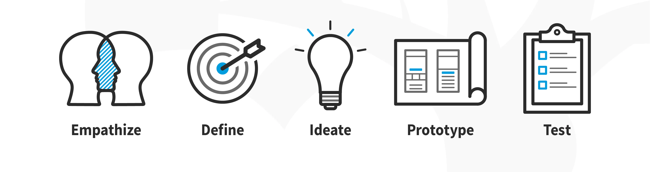
Introduction to Design Thinking
Design thinking is a human-centered problem-solving approach
It is a non-linear, iterative process that teams use to understand users, challenge assumptions, redefine problems and create innovative solutions to prototype and test

Slide 4
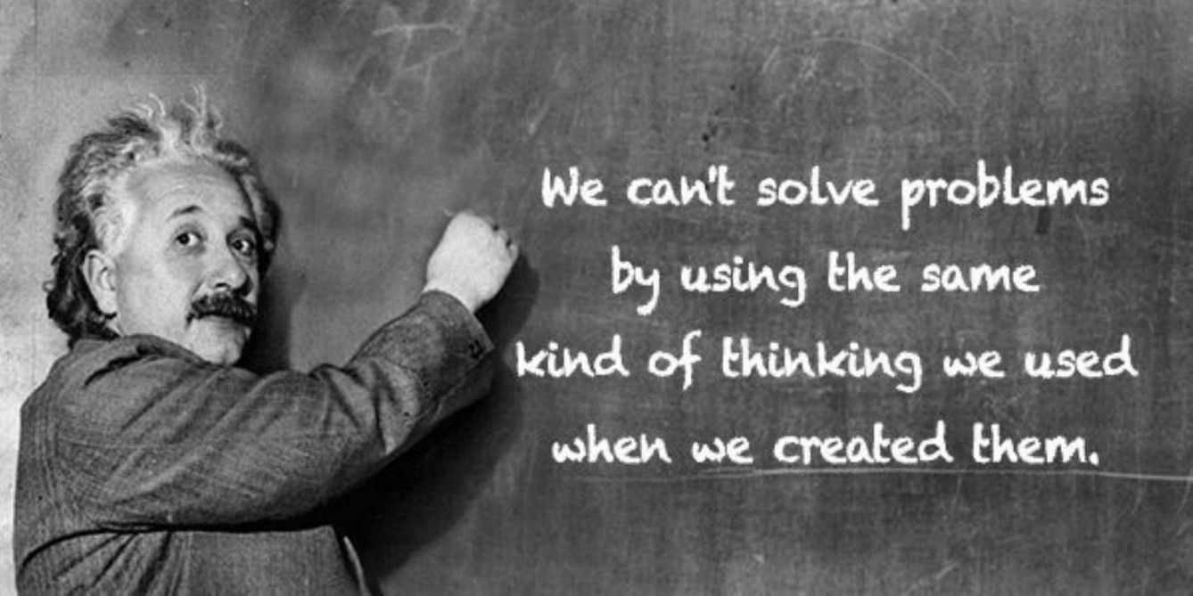
Latest Technology and futuristic ideas
We need to develop new ways of thinking to design better solutions, services and experiences that solve our current problems.
Design Thinking steps in with a bold newly systematized and non-linear human-centered approach.
This will help us radically change how we go about exploring problems and creating solutions to those problems.

Slide 5

Necessity for basic concepts and Various methods on needs exploration
A big part of product design is the process of exploration. In science, there’s this idea of “the adjacent possible”. The adjacent possible is the range of answers that exist in any given moment to the question, “Where do we go from here?”
In a typical game, at any one point, there is a finite number of moves that a player can make, based on the current state and the rules of the game. This finite set of moves defines the “adjacent possible” set of game states at any moment. A player is good when they can see the “adjacent possible” better than their opponents.
Similarly, product designers explore that exist within the constraints of systems, technology, the psychology and behaviors of users. At every point in the design process, there are ideas that are just one step away from the current state of thinking.
This “adjacent possible” is always changing as designers’ understanding of the problem continues to evolve, and the ideas that we pursue as we go. Technology design never happens in a straight line. It zigs, it zags, jumps sideways, backwards, and often end up in dead-ends.

Slide 6
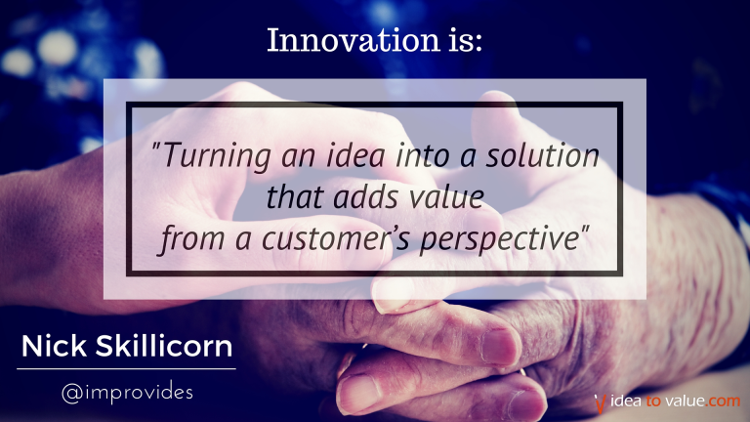
Talk on existing innovations
“Make changes in something established, especially by introducing new methods, ideas, or products”
Some of the interesting innovations:
AGRICULTURAL DRONES
ULTRAPRIVATE SMARTPHONES
BRAIN MAPPING
NEUROMORPHIC CHIPS
GENOME EDITING
MICROSCALE 3-D PRINTING

Slide 7
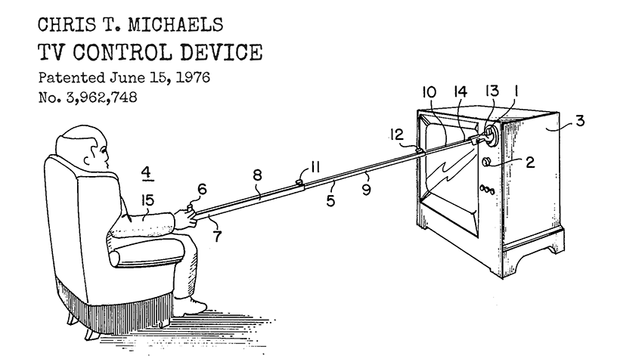
IPR & patent
Intellectual property rights are the rights given to persons over the creations of their minds. They usually give the creator an exclusive right over the use of his/her creation for a certain period of time.
A patent is an exclusive right granted for an invention, which is a product or a process that provides, in general, a new way of doing something, or offers a new technical solution to a problem. To get a patent, technical information about the invention must be disclosed to the public in a patent application.

Slide 8

Cost estimation
Cost Estimation is a statement that gives the value of the cost incurred in the manufacturing of finished goods.
Cost estimation helps in fixing the selling price of the final product after charging appropriate overheads and allowing a certain margin for profits.
It also helps in Inventory Reports drawing conclusions regarding the cost of production and in determining the necessity to introduce cost reduction techniques in order to improve the manufacturing process.

Slide 9

team dynamics
Team dynamics are the unconscious, psychological forces that influence the direction of a team’s behaviour and performance.
The design thinking process takes you into unknown and sometimes uncomfortable territory.
Members of a design thinking team need to be open minded, curious, collaborative and willing to have their assumptions challenged.
They also need to prepare themselves for change and take on an accepting, adaptable mindset.
Design thinking not only leads to increased innovation and improved end products, it also creates a great team spirit, boosts work ethic and bolsters individuals’ confidence in their creative abilities.

Slide 10

Thank you......

